Slide 1
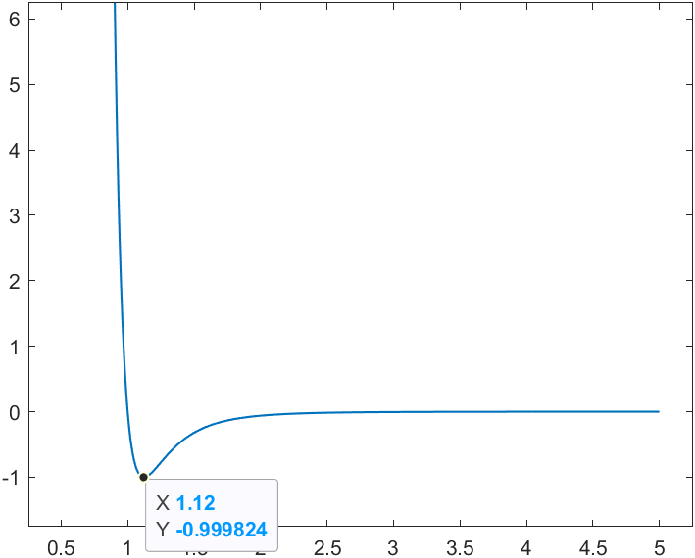
$${\ddot{x}}_{i}=\left[{\left(x_{i,i+1}\right)}^{−14}−{0.5\left(x_{i,i+1}\right)}^{−8}\right]\left(x_{i}−x_{i+1}\right)+\left[{\left(x_{i,i−1}\right)}^{−14}−{0.5\left(x_{i,i−1}\right)}^{−8}\right](x_{i}−x_{i−1})$$

Slide 2
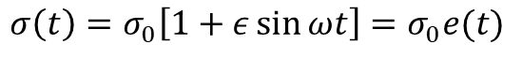
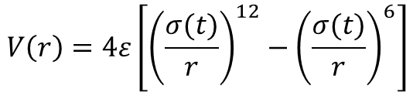

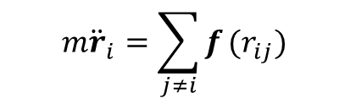
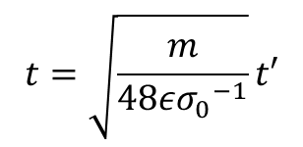
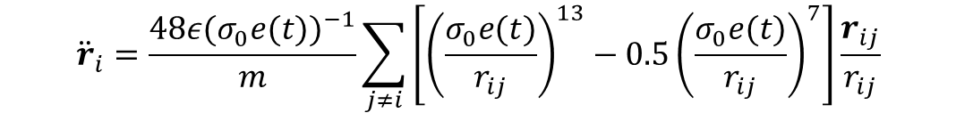
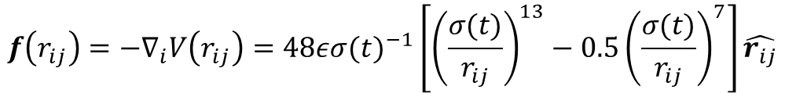

In a system of a large amount of particles interacting through LJ potential
$$V\left(r\right)=4ε\left[{\left(\frac{σ(t)}{r}\right)}^{12}−{\left(\frac{σ(t)}{r}\right)}^{6}\right]$$
$$m{\ddot{r}}_{i}=\sum_{j≠i}{f}(r_{ij})$$
Where the force
$$f\left(r_{ij}\right)=−∇_{i}V\left(r_{ij}\right)=48ε{σ(t)}^{−1}\left[{\left(\frac{σ(t)}{r_{ij}}\right)}^{13}−{0.5\left(\frac{σ(t)}{r_{ij}}\right)}^{7}\right]\hat{r_{ij}}$$
The interaction range is controlled by the particle size, modulated periodically
$$σ\left(t\right)=σ_{0}\left[1+ε\sin{ωt}\right]=σ_{0}e(t)$$
$${\ddot{r}}_{i}=\frac{48ε{(σ_{0}e(t))}^{−1}}{m}\sum_{j≠i}{\left[{\left(\frac{σ_{0}e(t)}{r_{ij}}\right)}^{13}−{0.5\left(\frac{σ_{0}e(t)}{r_{ij}}\right)}^{7}\right]\frac{r_{ij}}{r_{ij}}}$$
Normalize the time and space
$$t=\sqrt{\frac{m}{48ε{σ_{0}}^{−1}}}t′$$
$$r=σ_{0}r′$$
We get non-dimensionless equation
$${\ddot{r}}_{i}={(e(t))}^{−1}\sum_{j≠i}{\left[{\left(\frac{e(t)}{r_{ij}}\right)}^{13}−{0.5\left(\frac{e(t)}{r_{ij}}\right)}^{7}\right]\frac{r_{ij}}{r_{ij}}}$$

Slide 3


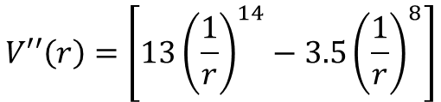
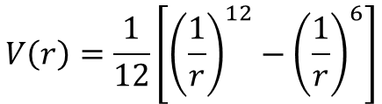
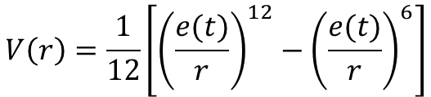
After some simplification
$${\ddot{r}}_{i}={({e(t)}^{2})}^{−1}\sum_{j≠i}{\left[{\left(\frac{{r_{ij}}^{2}}{{e(t)}^{2}}\right)}^{−7}−{0.5\left(\frac{{r_{ij}}^{2}}{{e(t)}^{2}}\right)}^{−4}\right]r_{ij}}$$
The equilibrium position
$$V\left(r\right)=\frac{1}{12}\left[{\left(\frac{e(t)}{r}\right)}^{12}−{\left(\frac{e(t)}{r}\right)}^{6}\right]$$
$$r_{0}=2^{1/6}e(t)$$
Without modulation
$$V\left(r\right)=\frac{1}{12}\left[{\left(\frac{1}{r}\right)}^{12}−{\left(\frac{1}{r}\right)}^{6}\right]$$
$$V′′\left(r\right)=\left[13{\left(\frac{1}{r}\right)}^{14}−3.5{\left(\frac{1}{r}\right)}^{8}\right]$$

Slide 4
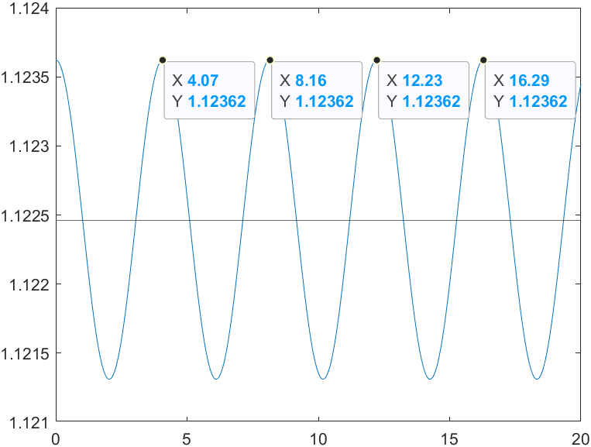
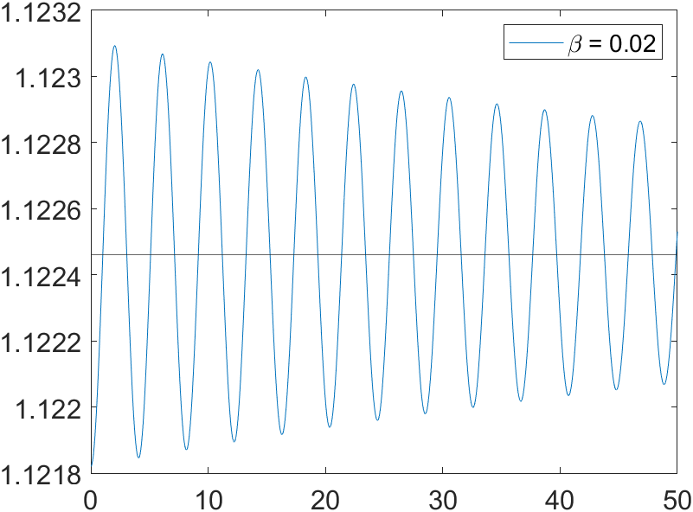
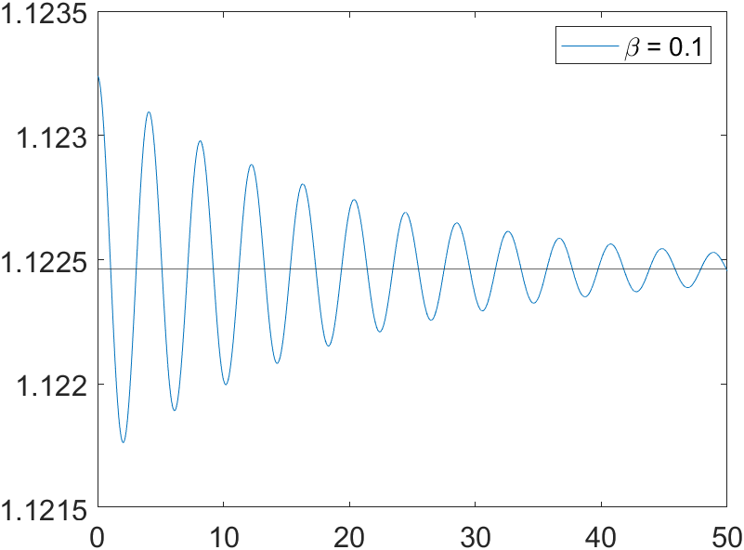
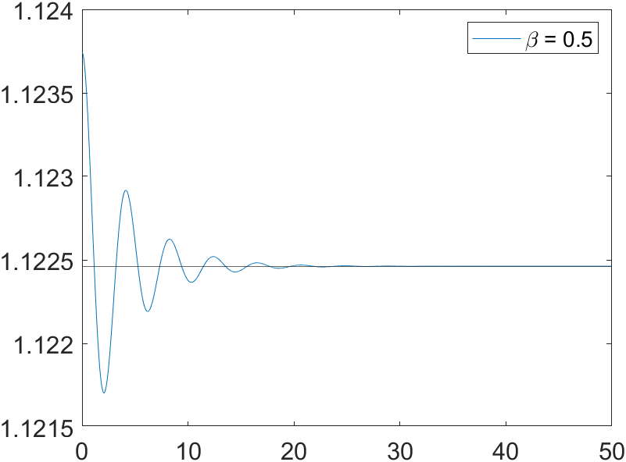
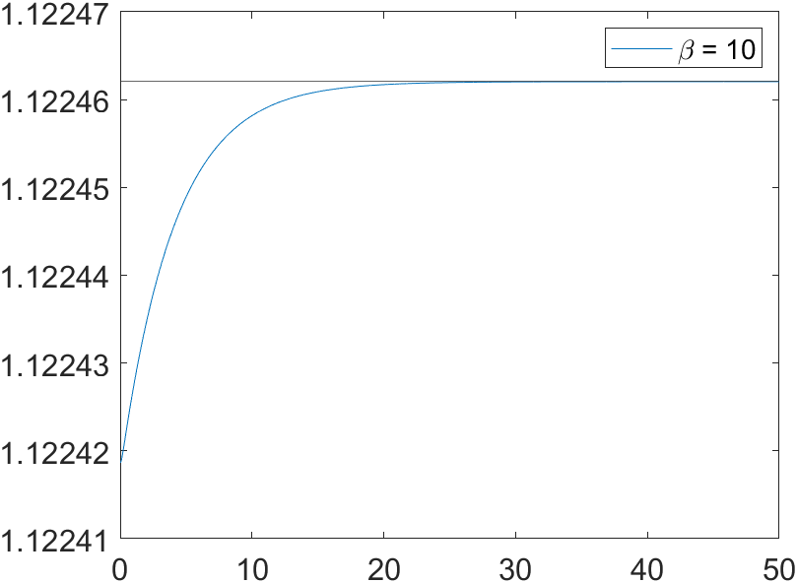
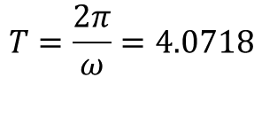
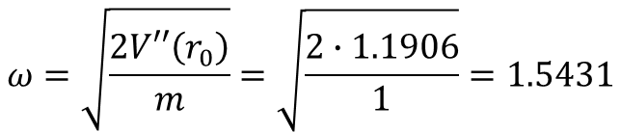
20251204/1: Normal Modes of two-particle system
The eigenfrequency for two frictionless particles
$$ω=\sqrt{\frac{2V′′\left(r_{0}\right)}{m}}=\sqrt{\frac{2∙1.1906}{1}}=1.5431$$
distance
$$T=\frac{2π}{ω}=4.0718$$
time
Add damping: Relax to the equilibrium distance

Slide 5
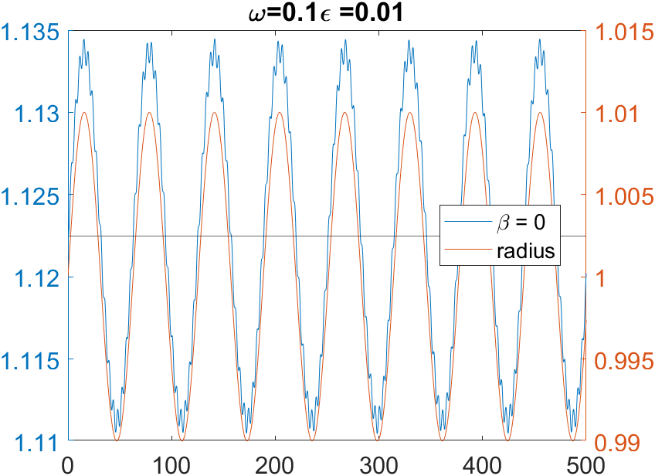
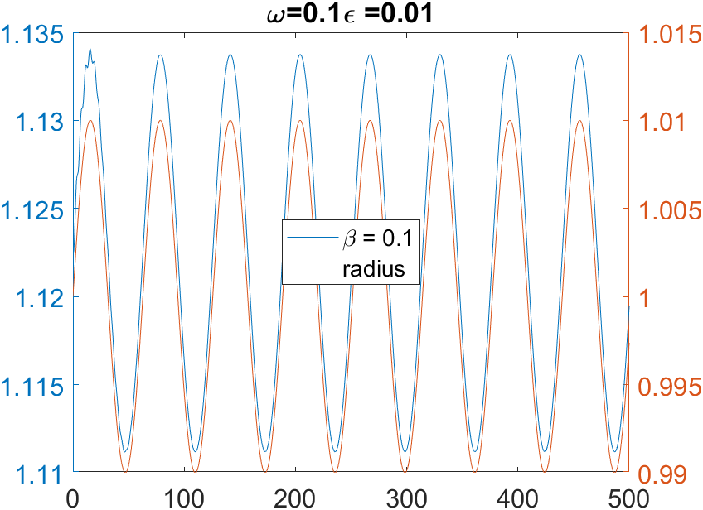
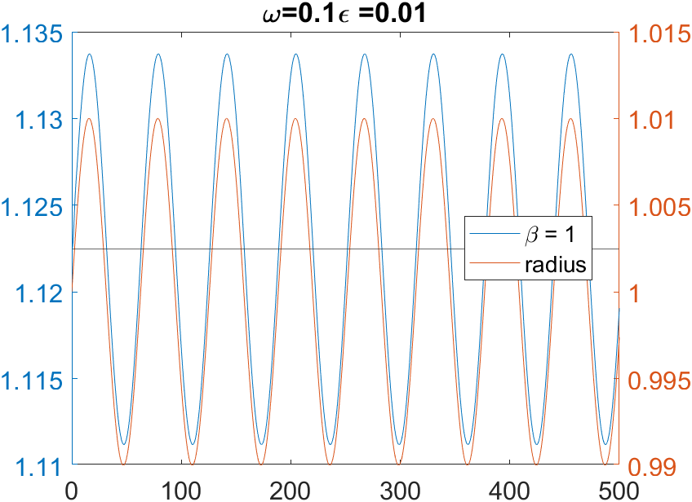
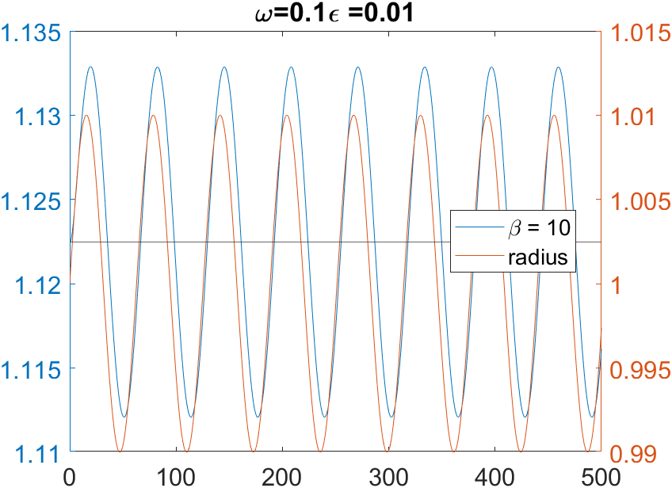
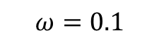
20251205/2: Time modulation of LJ Potential: Mimicking Bubble Pulsating
$$ω=0.1$$

Slide 6
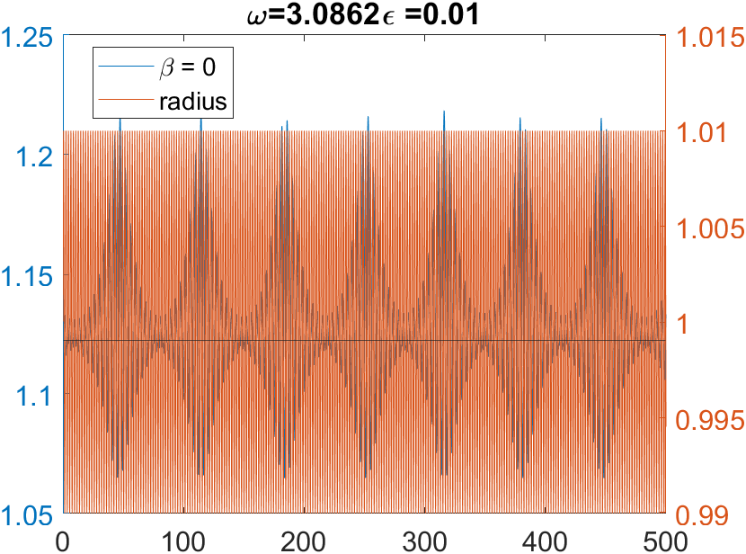
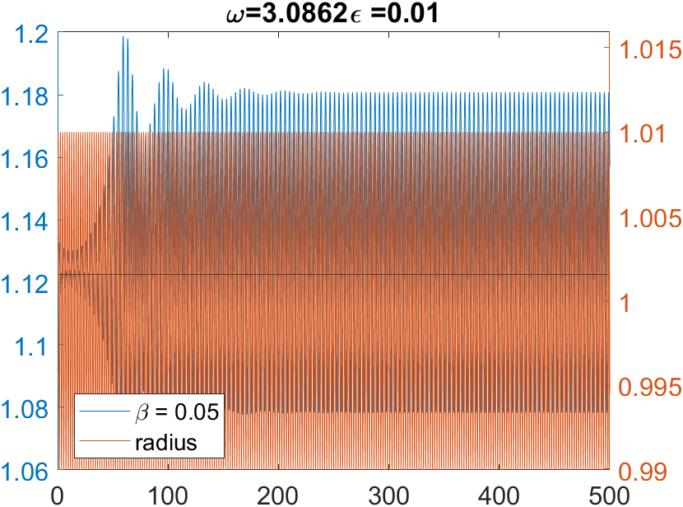
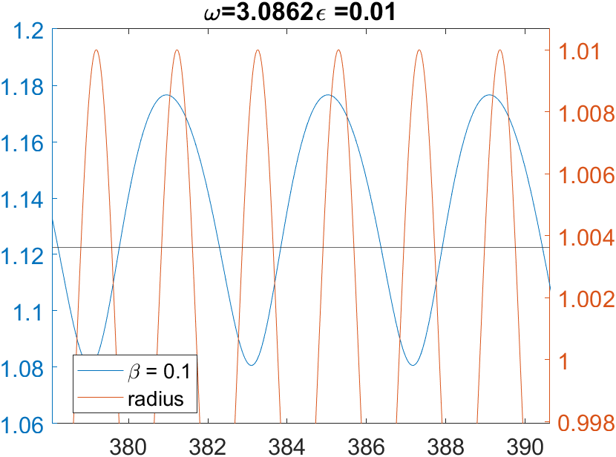
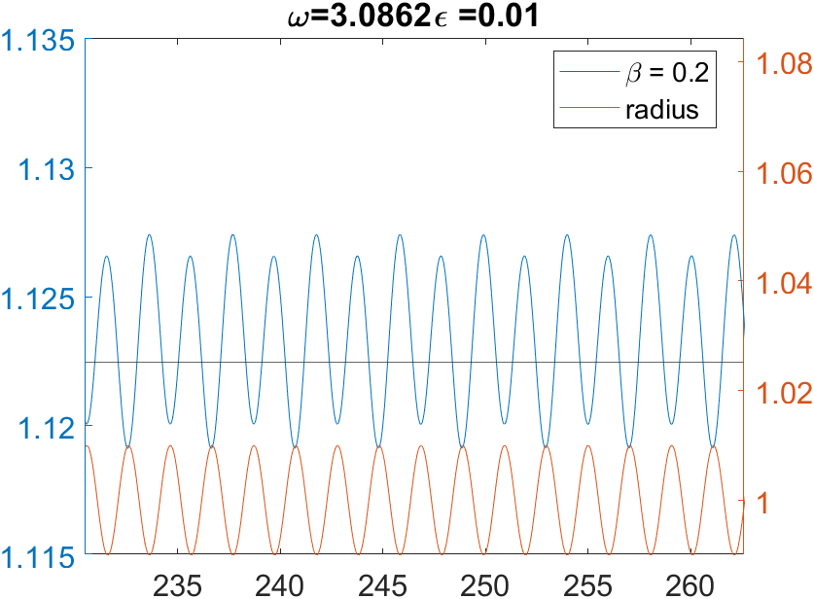
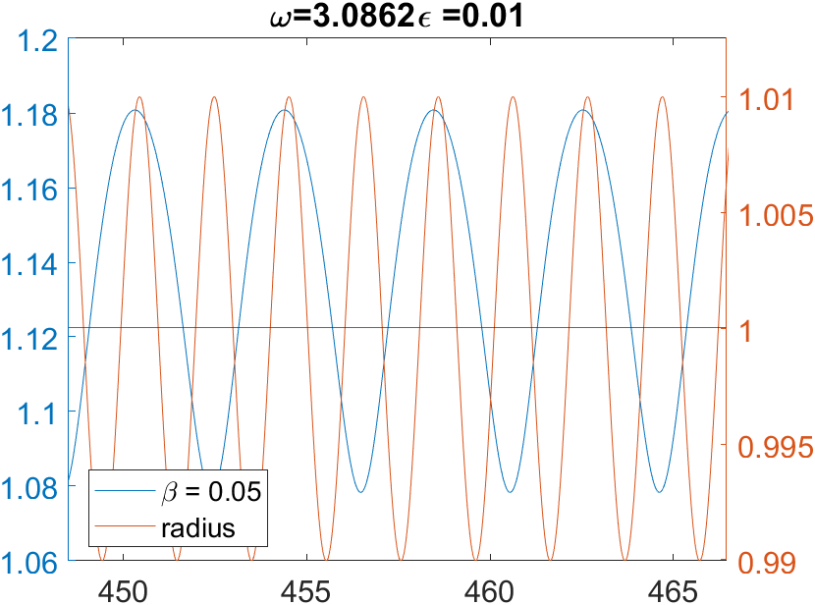
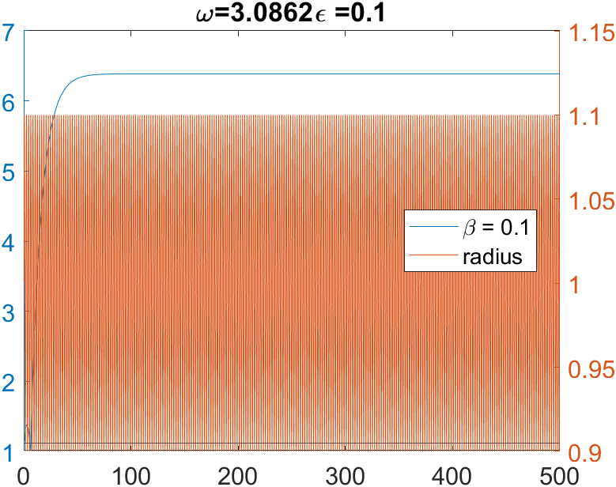
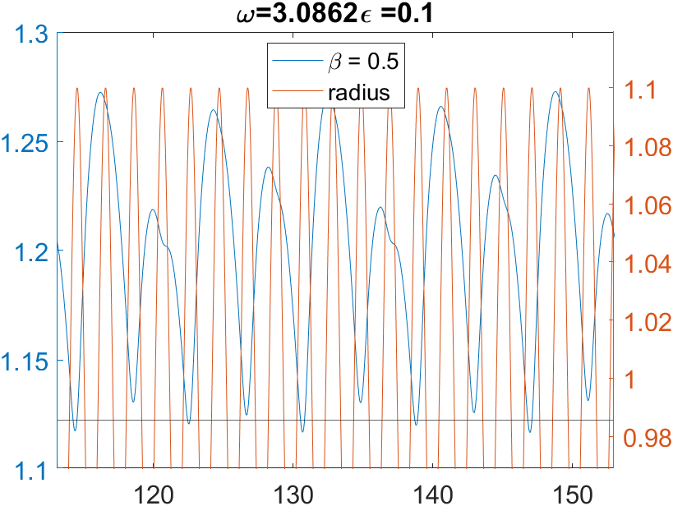
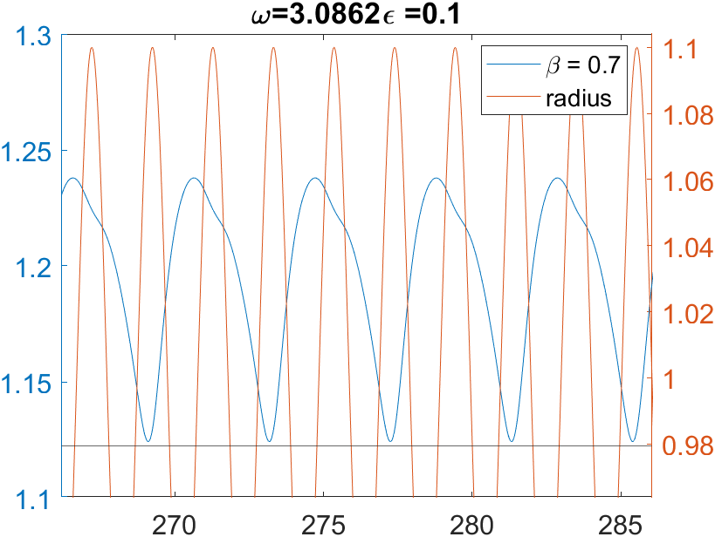
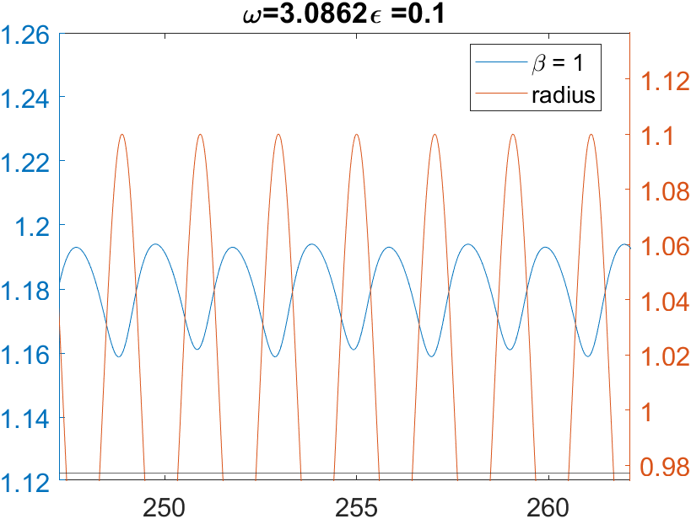
20251205/3: Parametric Excitation of the Normal Mode in n=2 system
Why Asymmetry? Because LJ, easier for
Separation, hard for merging

Slide 7
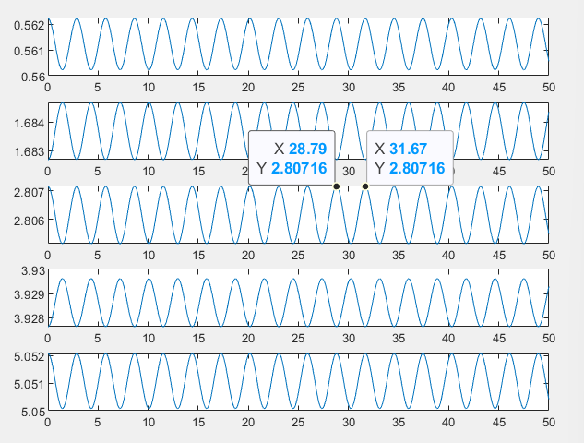
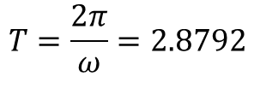
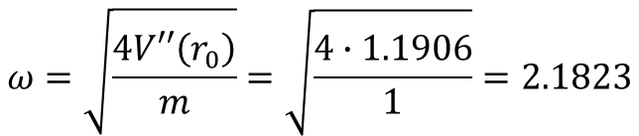
20251204/1: Normal Modes of N-particle system
The eigenfrequency for two frictionless particles
$$ω=\sqrt{\frac{4V′′\left(r_{0}\right)}{m}}=\sqrt{\frac{4∙1.1906}{1}}=2.1823$$
$$T=\frac{2π}{ω}=2.8792$$
31.67-28.79 = 2.88

Slide 8
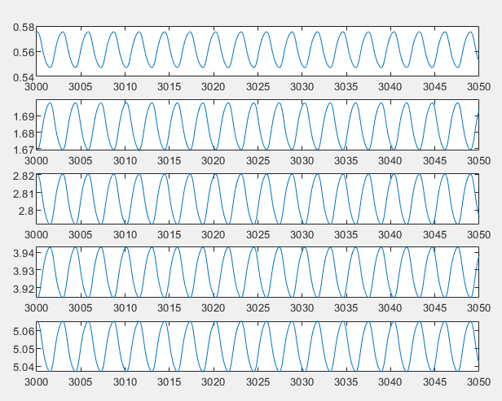
20251205/5: Parametric Excitation of the Normal Mode in n=N system
batch_omega = 2.1823*2;
batch_epsilon = 0.05;
beta = 1; % damping coefficient
N = 20; % number of particles
L = N*2^(1/6); % domain width
rc = 1.5; % cut off distance of Lennard Jones potential
perturbation = 1E-3*ones(N,1); perturbation(2:2:end) = -perturbation(2:2:end);
x0 = (0:N-1).'*2^(1/6) + 2^(1/6)/2 + perturbation;

Slide 9
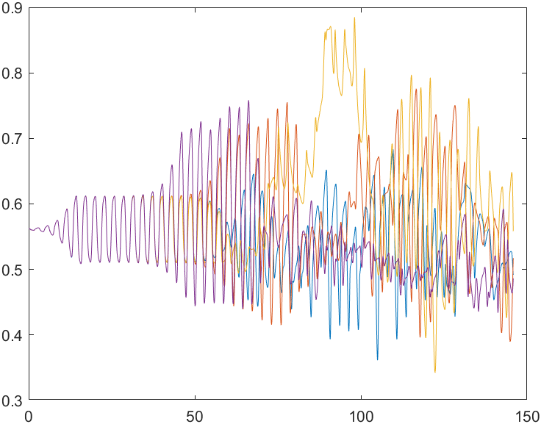
batch_omega = 2.1823*2;
batch_epsilon = 0.10;
beta = 1; % damping coefficient
N = 20; % number of particles
L = N*2^(1/6); % domain width
rc = 1.5; % cut off distance of Lennard Jones potential
perturbation = 1E-3*ones(N,1); perturbation(2:2:end) = -perturbation(2:2:end);
x0 = (0:N-1).'*2^(1/6) + 2^(1/6)/2 + perturbation;
No convergence AT ALL ….

Slide 10
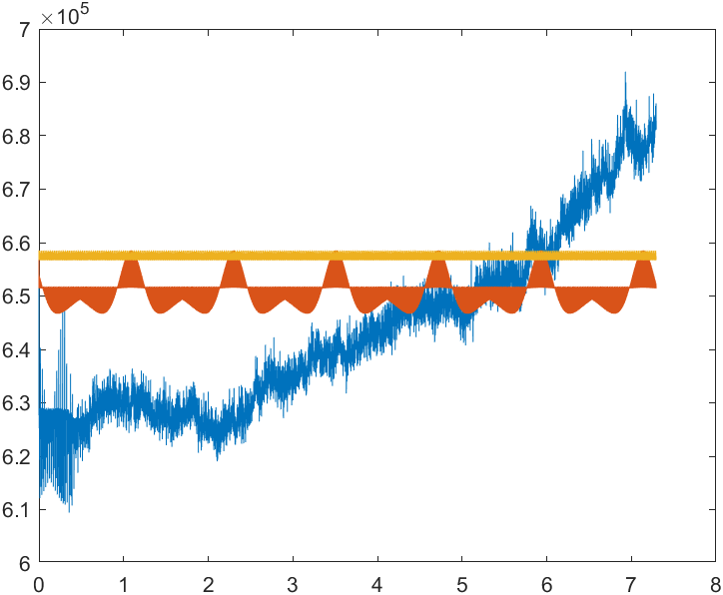
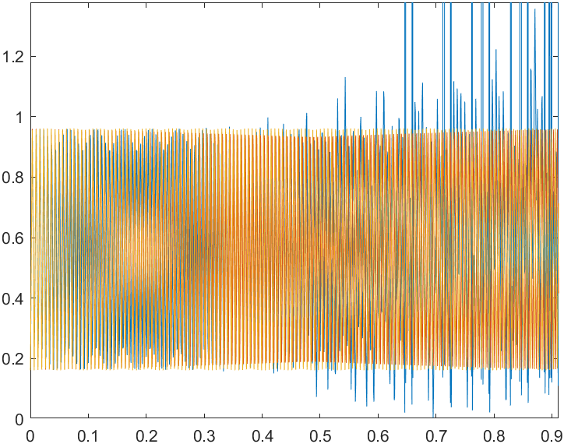
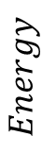
20251205/6: Nonlinear Normal Mode in 2D LJ system
$$Energy$$

Slide 11
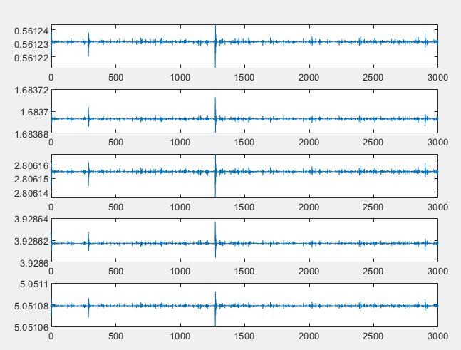
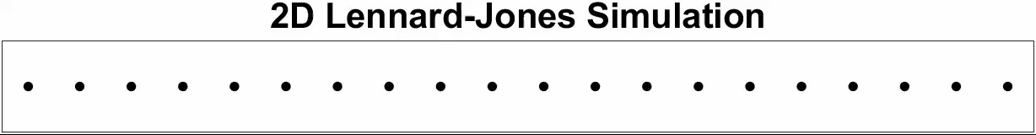
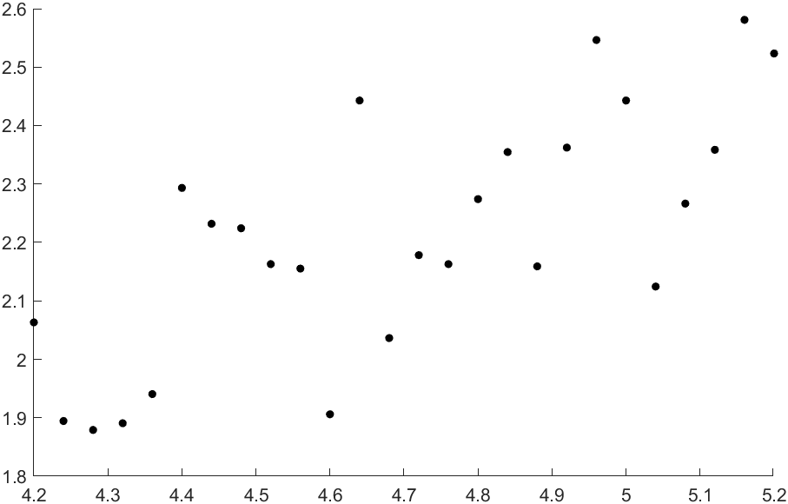
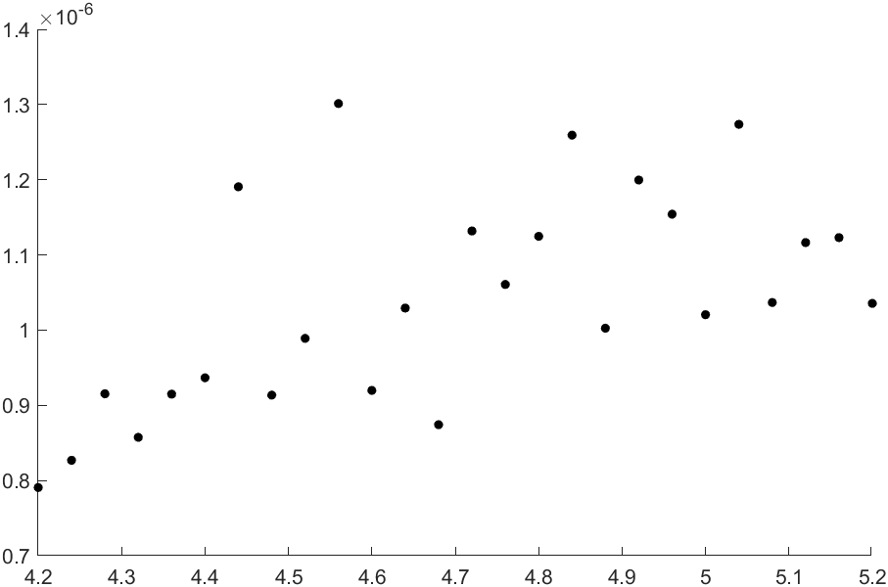
res_N=20_rho=2.00_beta=1.4_epsilon=0.04 (1)

Slide 12
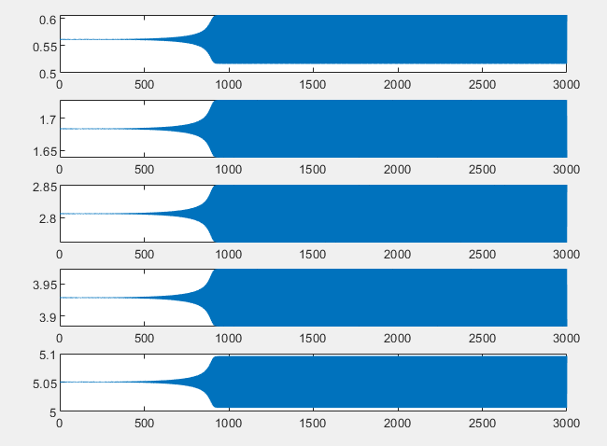

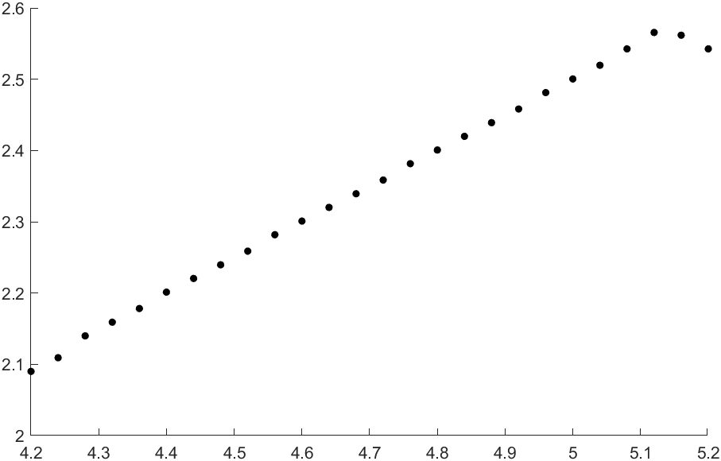
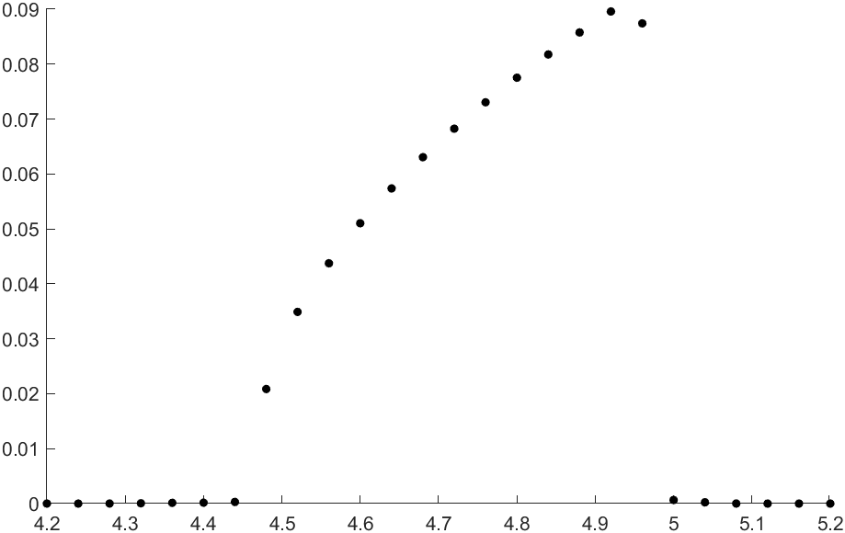
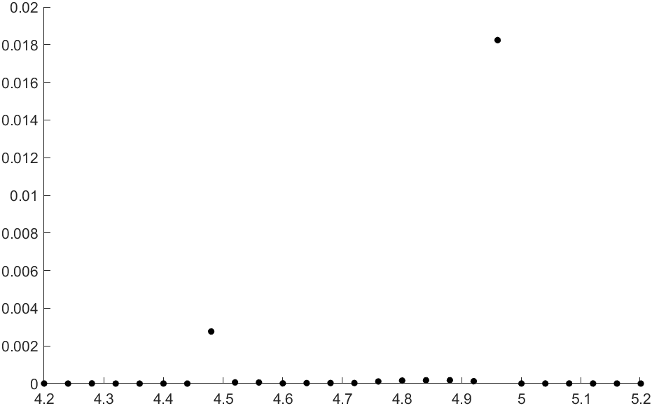
res_N=20_rho=2.00_beta=1.4_epsilon=0.07
Long Transient State

Slide 13
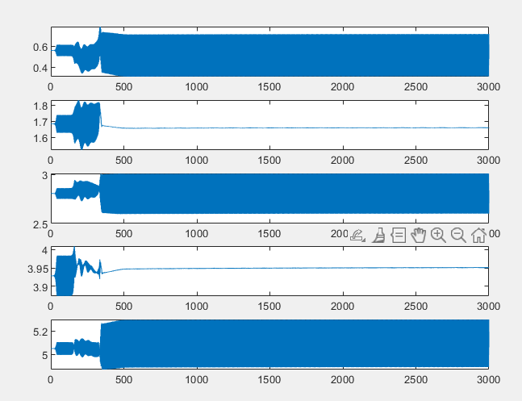

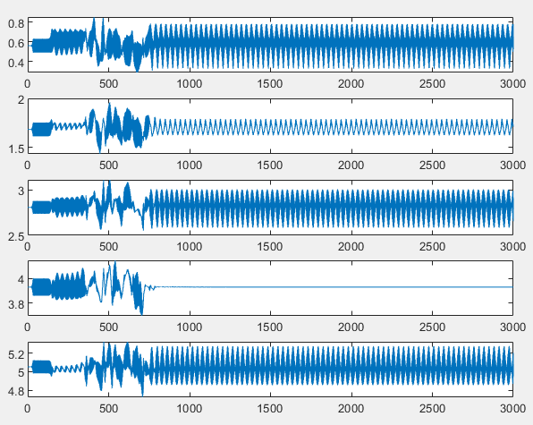

res_N=20_rho=2.00_beta=1.4_epsilon=0.10
Nonliear Breather?
Omega = 4.64
Omega = 5.08
Notes:
What you are seeing is a nonlinear lattice mode, not a normal phonon of a mono-atomic chain.
In a 1D mono-atom chain, linear theory allows only sinusoidal normal modes with period set by the wavelength:
There is no linear mode where every third particle is stationary.
So the pattern you describe
move left → middle almost stops → move right → repeat
with period-3 in space is a hallmark of nonlinearity.

Slide 14
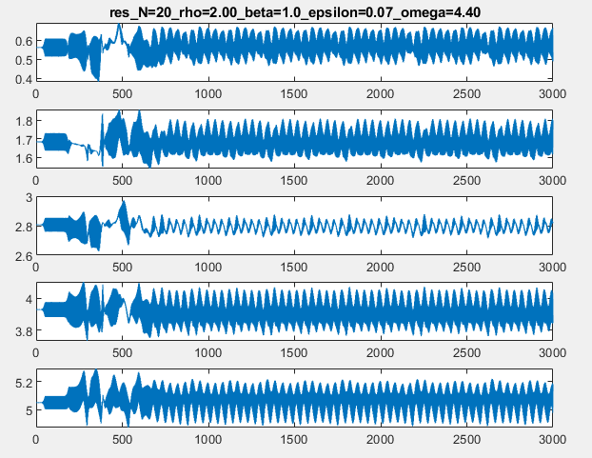




Slide 15


Slide 16











$$v\left(jh\right)={\dot{r}}_{i}\left(jh\right)=\frac{r_{i}\left(jh+h\right)−r_{i}\left(jh−h\right)}{2h}$$
$${a\left(jh\right)=\ddot{r}}_{i}(jh)=\frac{r_{i}\left(jh+h\right)+r_{i}\left(jh−h\right)−2r_{i}\left(jh\right)}{h^{2}}$$
$${\ddot{r}}_{i}=\sum_{j≠i}{\left[{\left(r_{ij}\right)}^{−14}−{0.5\left(r_{ij}\right)}^{−8}\right](r_{i}−r_{j})}$$
$$\frac{r_{i}\left(jh+h\right)+r_{i}\left(jh−h\right)−2r_{i}\left(jh\right)}{h^{2}}=\sum_{j≠i}{\left[{\left(r_{ij}\right)}^{−14}−{0.5\left(r_{ij}\right)}^{−8}\right](r_{i}−r_{j})}$$
Initial Condition
$$r_{i}(0)$$
$$v_{i}(0)$$
$$r_{i}\left(h\right)=r_{i}\left(0\right)+v_{i}\left(0\right)h+0.5{\ddot{r}}_{i}(0)h^{2}$$
$$r_{i}\left(jh+h\right)=−r_{i}\left(jh−h\right)+2r_{i}\left(jh\right)+\sum_{j≠i}{\left[{\left(r_{ij}\right)}^{−14}−{0.5\left(r_{ij}\right)}^{−8}\right](r_{i}−r_{j})}h^{2}$$
$$r_{i}\left(jh+h\right)=−r_{i}\left(jh−h\right)+2r_{i}\left(jh\right)+{\ddot{r}}_{i}(jh)h^{2}$$
$${\ddot{r}}_{i}=−β{\dot{r}}_{i}+\sum_{j≠i}{\left[{\left(r_{ij}\right)}^{−14}−{0.5\left(r_{ij}\right)}^{−8}\right](r_{i}−r_{j})}$$
$$r_{i}\left(jh+h\right)+r_{i}\left(jh−h\right)−2r_{i}\left(jh\right)=−\frac{βh}{2}(r_{i}\left(jh+h\right)−r_{i}\left(jh−h\right))+\sum_{j≠i}{\left[{\left(r_{ij}\right)}^{−14}−{0.5\left(r_{ij}\right)}^{−8}\right](r_{i}−r_{j})h^{2}}$$
Initial Condition
$$r_{i}(0)$$
$$v_{i}(0)$$
$$(1+\frac{βh}{2})r_{i}\left(jh+h\right)=(−1+\frac{βh}{2})r_{i}\left(jh−h\right)+2r_{i}\left(jh\right)+\sum_{j≠i}{\left[{\left(r_{ij}\right)}^{−14}−{0.5\left(r_{ij}\right)}^{−8}\right](r_{i}−r_{j})h^{2}}$$
$$r_{i}\left(h\right)=r_{i}\left(0\right)+v_{i}\left(0\right)h+0.5a(0)h^{2}$$
$$r_{i}\left(jh+h\right)=−r_{i}\left(jh−h\right)+2r_{i}\left(jh\right)+a(jh)h^{2}$$

Slide 17



Slide 19

Energy Conserved?
Attraction is not strong enough?

